Slide 1
Proxy webserver
Group Members
Ankit
Nehul choudhary
Sarthak Agrawal
Razina Khanam
Priyanshu Kaushik

Slide 2
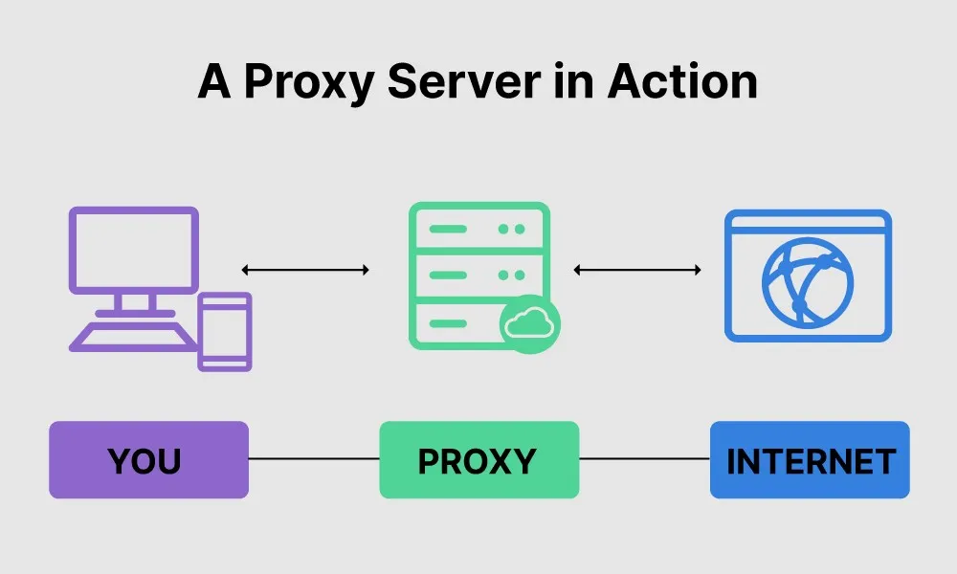
Use of Proxy webserver
A proxy server provides a gateway between users and the internet. It is a server, referred to as an “intermediary” because it goes between end-users and the web pages they visit online. When a computer connects to the internet, it uses an IP address.

Slide 3
Source code
def __init__(self, config):
# Shutdown on Ctrl+C
signal.signal(signal.SIGINT, self.shutdown)
# Create a TCP socket
self.serverSocket = socket.socket(socket.AF_INET, socket.SOCK_STREAM)
# Re-use the socket
self.serverSocket.setsockopt(socket.SOL_SOCKET, socket.SO_REUSEADDR, 1)
# bind the socket to a public host, and a port
self.serverSocket.bind((config['HOST_NAME'], config['BIND_PORT']))
self.serverSocket.listen(10) # become a server socket
self.__clients = {} while True:
# Establish the connection
(clientSocket, client_address) = self.serverSocket.accept()
d = threading.Thread(name=self._getClientName(client_address),
target = self.proxy_thread, args=(clientSocket, client_address))
d.setDaemon(True)
d.start()

Slide 4
Source code
# get the request from browser
request = conn.recv(config['MAX_REQUEST_LEN'])
# parse the first line
first_line = request.split('\n')[0]
# get url
url = first_line.split(' ')[1]
http_pos = url.find("://") # find pos of ://
if (http_pos==-1):
temp = url
else:
temp = url[(http_pos+3):] # get the rest of url
port_pos = temp.find(":") # find the port pos (if any)
# find end of web server
webserver_pos = temp.find("/")
if webserver_pos == -1:
webserver_pos = len(temp)
webserver = ""
port = -1
if (port_pos==-1 or webserver_pos < port_pos):

Slide 5
Source code
# default port
port = 80
webserver = temp[:webserver_pos]
else: # specific port
port = int((temp[(port_pos+1):])[:webserver_pos-port_pos-1])
webserver = temp[:port_pos]
s = socket.socket(socket.AF_INET, socket.SOCK_STREAM)
s.settimeout(config['CONNECTION_TIMEOUT'])
s.connect((webserver, port))
s.sendall(request)
while 1:
# receive data from web server
data = s.recv(config['MAX_REQUEST_LEN'])
if (len(data) > 0):
conn.send(data) # send to browser/client
else:
break

Slide 6
Socket Programing elements in source code
Protocol (TCP)
self.serverSocket = socket.socket(socket.AF_INET, socket.SOCK_STREAM)
Port number of the server
self.serverSocket.bind((config['HOST_NAME'], config['BIND_PORT']))

Slide 7
Socket Programing elements in source code
Port number of the client
port = 80
webserver = temp[:webserver_pos]
else: # specific port
port = int((temp[(port_pos+1):])[:webserver_pos-port_pos-1])
webserver = temp[:port_pos]
IP address of the client
(clientSocket, client_address) =self.serverSocket.accept()

Slide 8
Additional proxy webserver features
Blacklisting Domains
– Content monitoring
– Logging
– HTTP Webserver + Proxy Server

Slide 9
Socket Programing elements in Additional proxy webserver features
IP address of client
Port number of client
IP address of server
Port number of client
Protocol

Slide 10
Link to public GITHUB project

